Slide 1

Clemson Athletics
TJ Wilson, James Talton, alana bergin, Ansley martin

Slide 2
What Test Did We Use?
  For our tests, we used a single factor ANOVA test
  What is a single factor ANOVA test?
  A single factor ANOVA is a test for the difference of means between multiple groups.
    Using Single Factor Anova and Descriptive Statistics, we tested the difference in means between home versus away games are different.

Slide 3
Null hypotheses
Hο: The mean of points for home games are equal to the mean of points for away games.
Hα: The mean of points for home games are NOT equal to the mean of points for away games.
Hο: The mean rushing yards for home games are equal to the mean rushing yards for away games.
Hα: The mean rushing yards for home games are NOT equal to the mean rushing yards for away games.
Hο: The mean throws completed for home games are equal to the mean throws completed for away games.
Hα: The mean throws completed for home games are NOT equal to the mean throws completed for away games.
Hο: The mean throws intercepted for home games are equal to the mean throws intercepted for away games.
Hα: The mean throws intercepted for home games are NOT equal to the mean throws intercepted for away games.

Slide 4
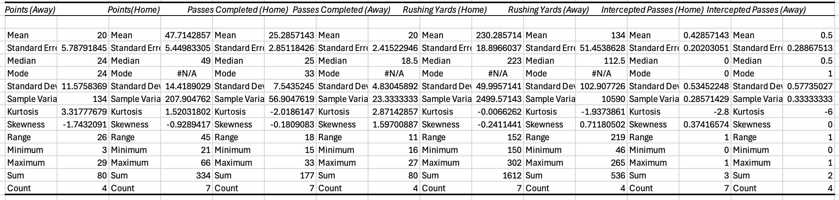
Descriptive Statistics (Excel)
In looking at the descriptive statistics, we already became skeptical that all means would be equal when comparing the mean, variation, range, median of each data-set compared between home and away statistics.
The tests would certainly tell us more, but there were also more home games than away games, which could skew the data in a certain way with more data.

Slide 5
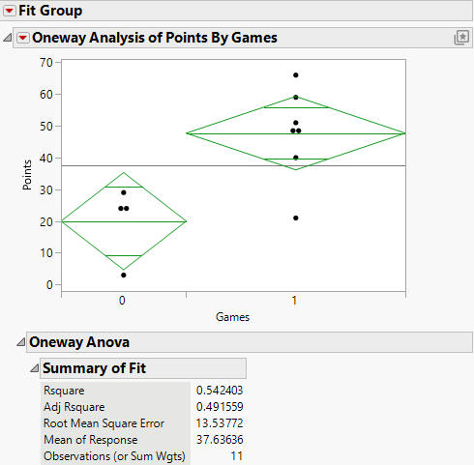
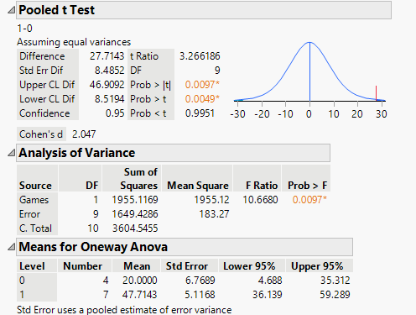
ANOVA Single Factor Test Points
JMP

Slide 6

Points Analysis
Given an extremely low p-value, we can deduct that there’s an extremely high level of significance between the means of “points scored” and our home and away games. This means that we reject our null hypothesis.
Looking at RSquare, we have a level of .54, which indicates that there is a “good” correlation for our means of “points” in relation to our home and away games.

Slide 7
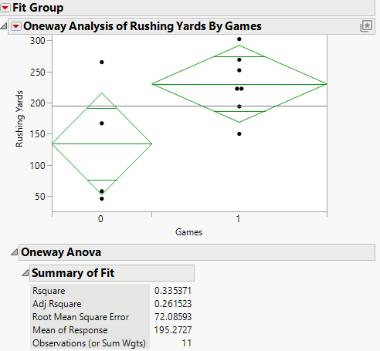
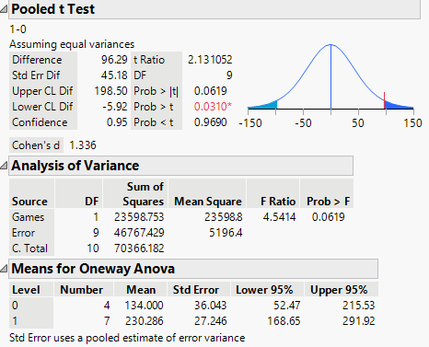
ANOVA Single Factor Test Rushing Yards
JMP

Slide 8

Rushing Yards Analysis
Given a high p-value, we can deduct that there’s a low level of significance in the means of “rushing yards” between our home and away games. This means that we fail to reject our null hypothesis.
Looking at RSquare, we have a level of .335, which indicates that there is a somewhat moderate correlation for our means of “rushing yards” in relation to our home and away games.

Slide 9
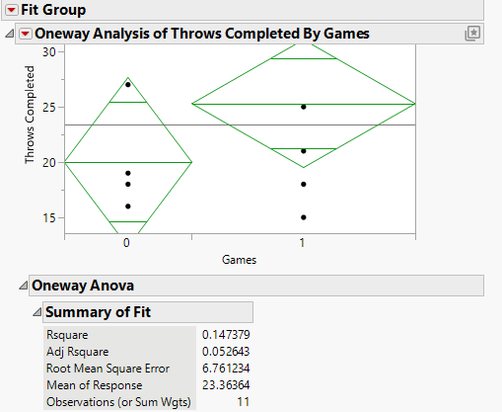
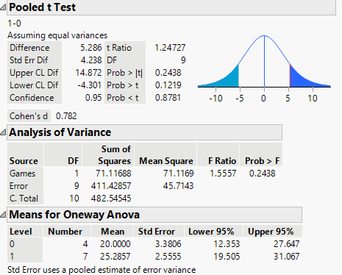
ANOVA Single Factor Test Throws Completed
JMP

Slide 10

Throws Completed Analysis
Given a very high p-value of .24 , we can deduct that there’s a pretty low level of significance between the means of “throws completed” and our home and away games. This means that we fail to reject our null hypothesis.
Looking at our RSquare, we have a level of .147, which indicates that there is a pretty low level of correlation for our means of “throws completed” in relation to our home and away games.

Slide 11
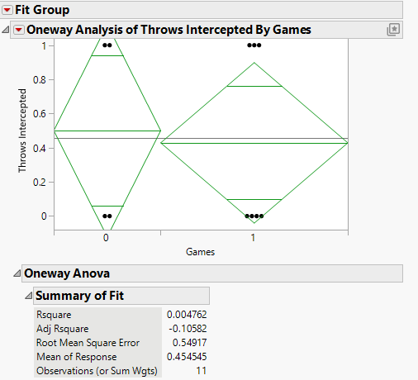
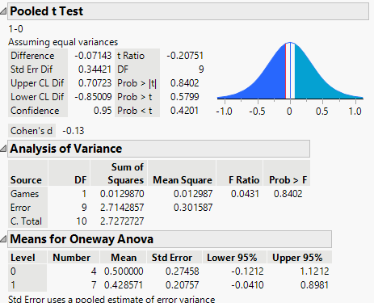
ANOVA Single Factor Test Throws Intercepted
JMP

Slide 12

Throws Intercepted Analysis
Given a p-value of .8 , we can deduct that there’s an extremely low level of significance between the means of “throws intercepted” and our home and away games. This means that we fail to reject our null hypothesis.
Looking at our RSquare, we have a level of .004, which indicates that there is almost 0 level of correlation for our means of “throws intercepted” in relation to our home and away games.

Slide 13
Results and Conclusion
From these findings, we conclude Clemson football shows significant variations in points scored and almost significant variations in rushing yards based on whether the game is played at home or away.
We fail to reject the Null hypothesis in every case but one, and a potential advantage can be observed when Clemson is home rather than away when analyzing rushing yards and points.
On the other hand, there is no significant difference in the number of completed passes or throws intercepted, which suggests that where the game is played has less influence on completed passes or throws intercepted than points scored or rushing yards.

